Slide 1
Forecasting Changes in Jobs for Private and Govt Roles
By Jennifer Lee

Slide 2
The Problem: Job Changes Per Month
Forecast the change in Total Jobs (Private and Government ) each month
Early Recruiting sparked my interest in how organizations forecast future staffing needs
Notes:
Important to note that this means you are regularly forecasting negative numbers
I signed my job 1+ before I was scheduled to start working, was curious how people predict their needs that far in advance, and so I wanted to learn more about predicting jobs

Slide 3
The Data:
Variable | Variable Name | Measured Units | Allowed Values | Description
Date | Date | mm/dd/yyyy | 01/01/2007-12/01/2019 | Date the statistic was publsihed
Month | Mon | Text | Jan-Dec | Month of the report
Year | Year | Numeric | 2007-2019 | Year of the report
Total Jobs (Private and Government) | Jobs | Numeric | 0-10000000000 | Numeric Change between Jobs in current month to previous, in thousands
Data Source: Bureau of Labor and Statistics
Produce monthly reports the US market and economy (employment, inflation, salary, etc)
Data is audited, methods are published, and quality controls are uses

Slide 4
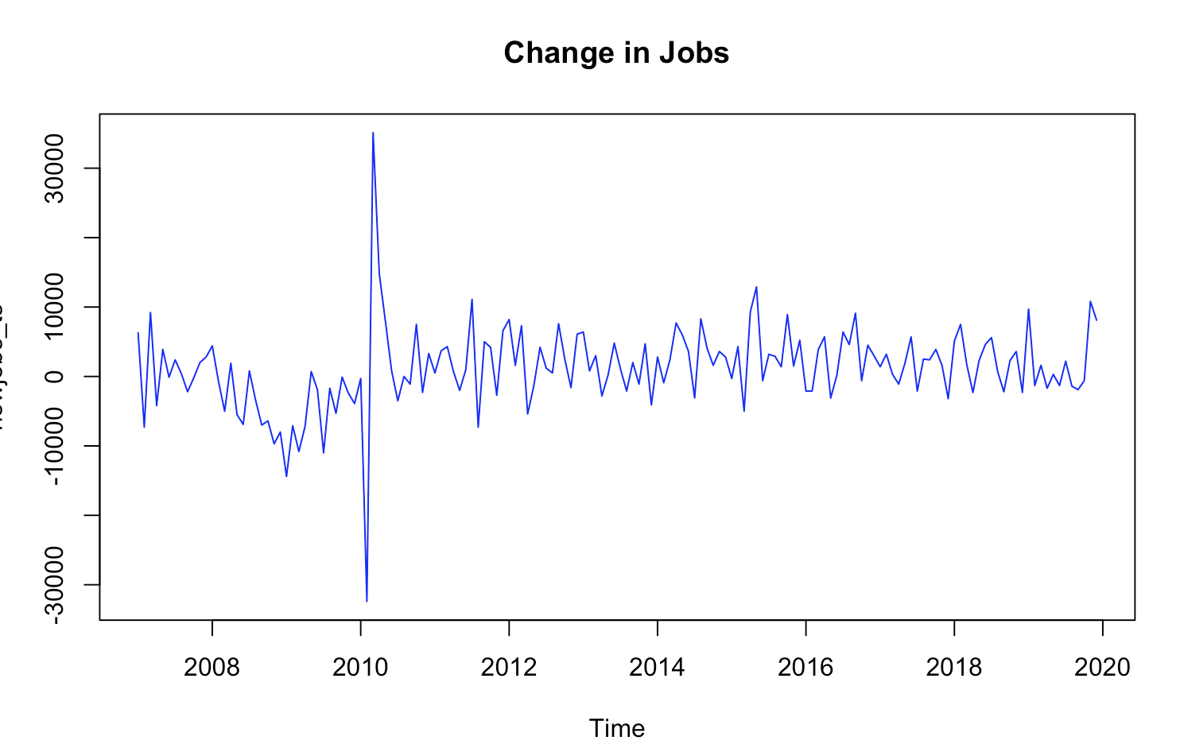
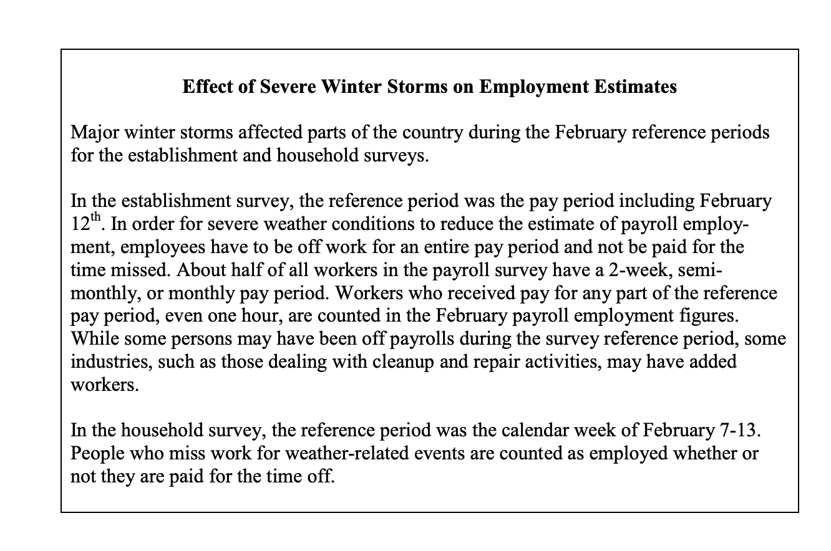
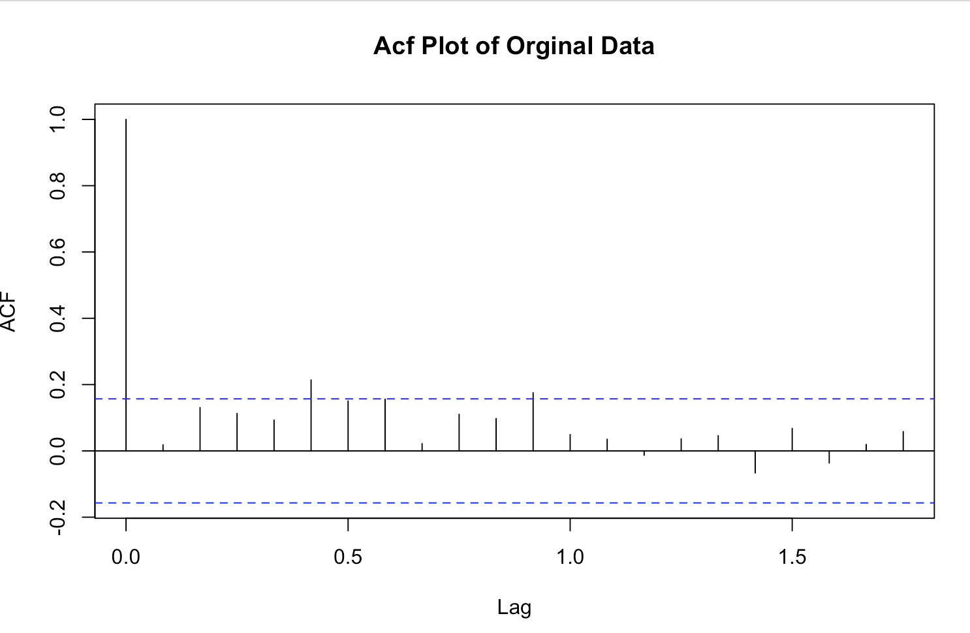
Methodology
Chose to forecast beyond 2010
Choose MAPE as accuracy measure, as self comparison highlights true error
Notes:
Snow issues, this is before work from home days, so there were a lot of people who met the conditions of “not working” that month which was repsorted as a net job loss, yet the next month they were reported as a new job added
ME smooths out the bad positive and negative periods, reference the 2010 period to discuss how the ME here would have been very low , yet neglect to reflect the error present

Slide 5
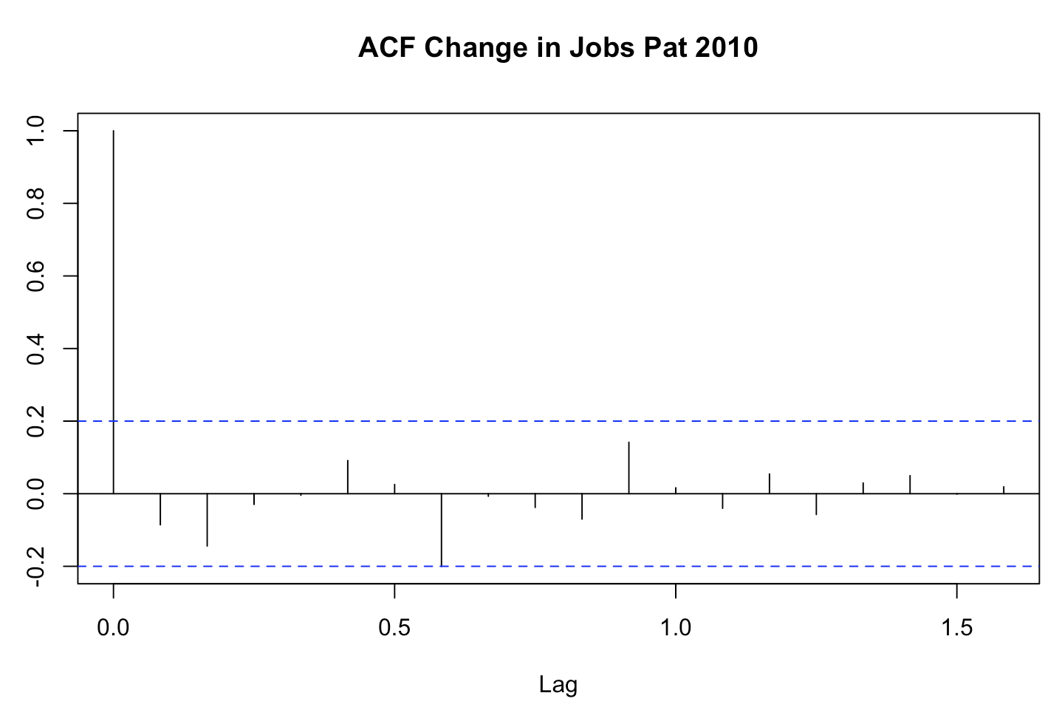
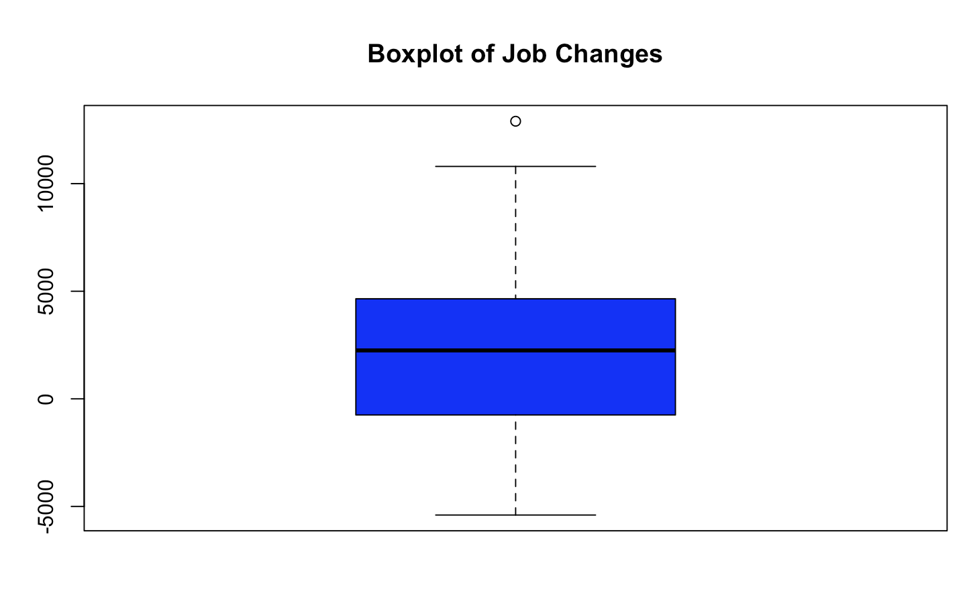
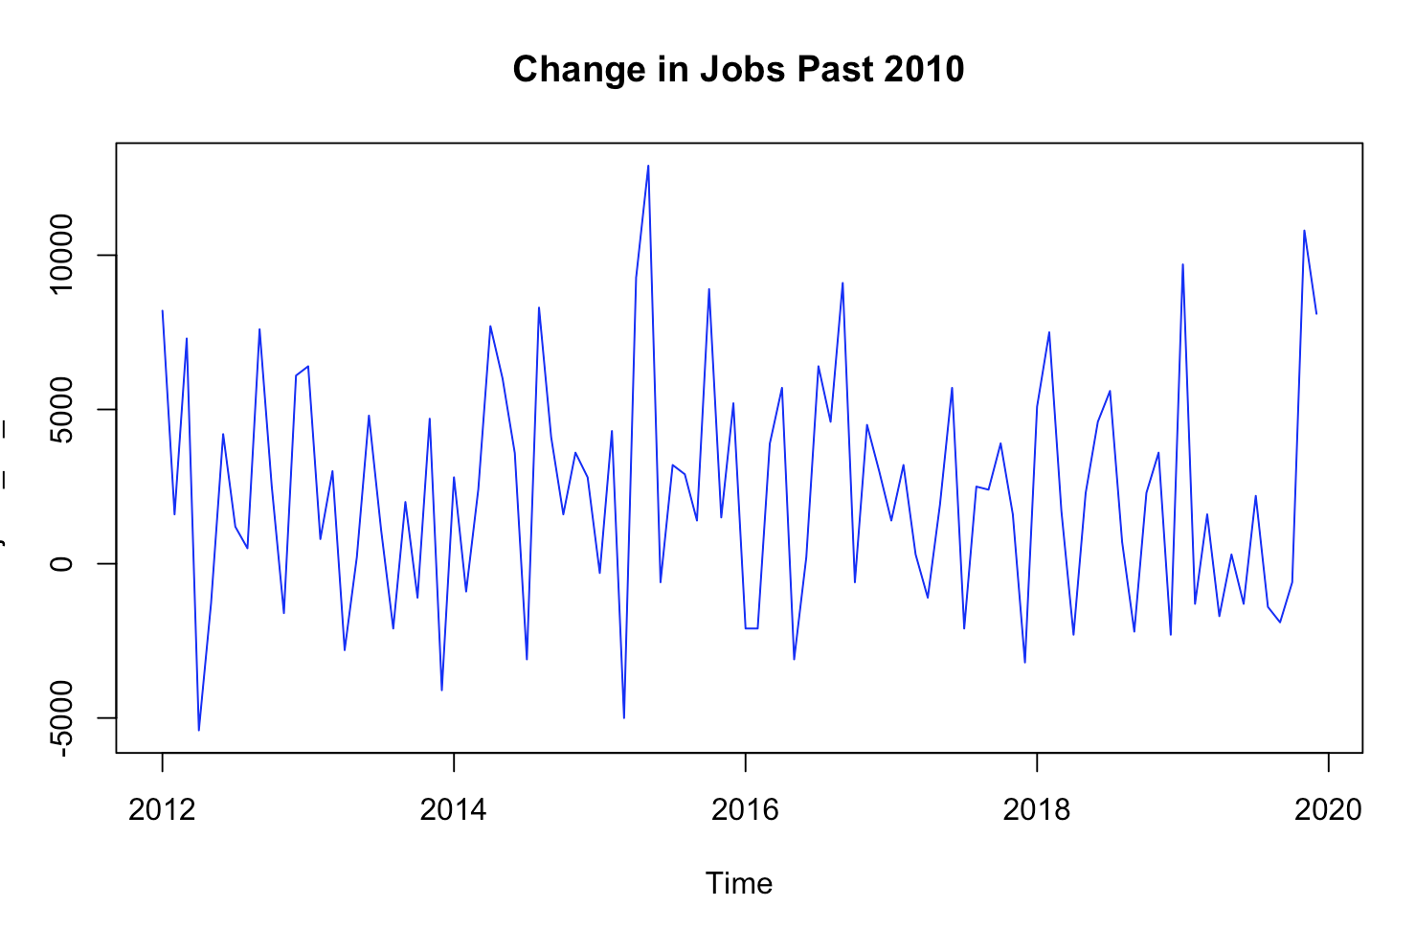
Data Exploration Past 2010

Slide 6
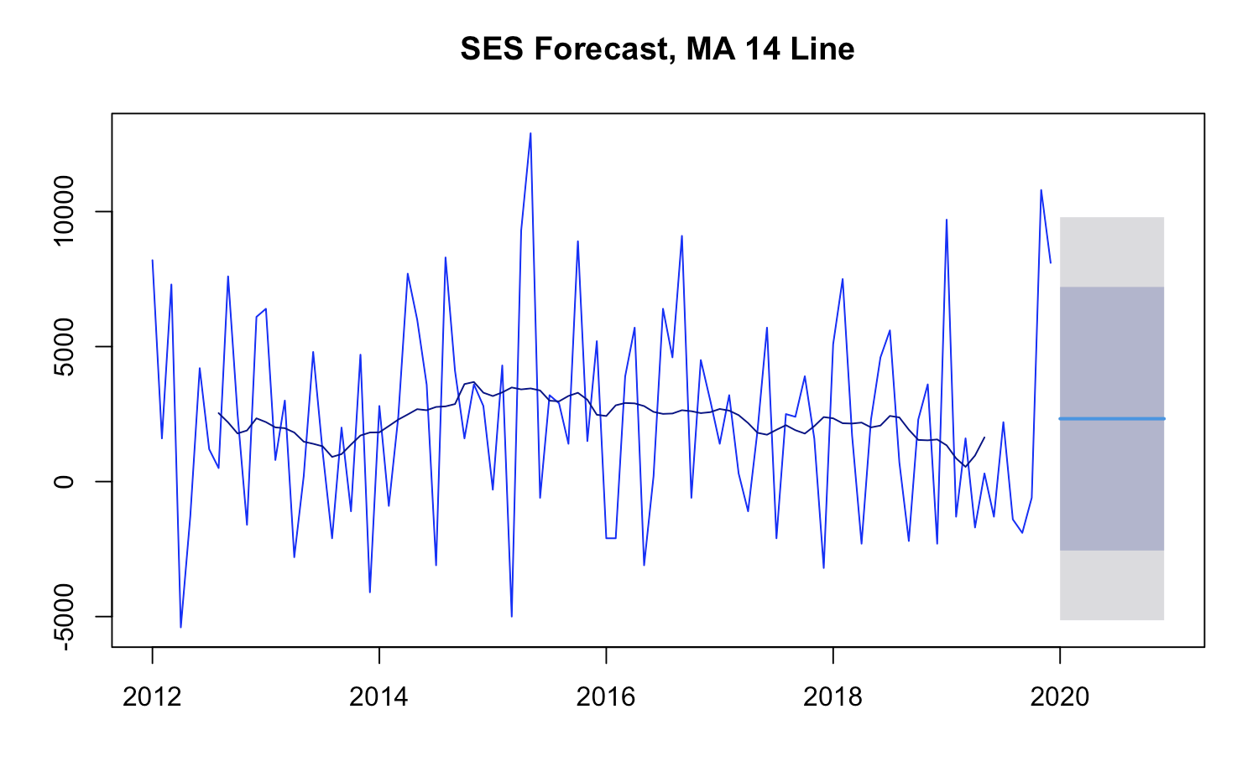
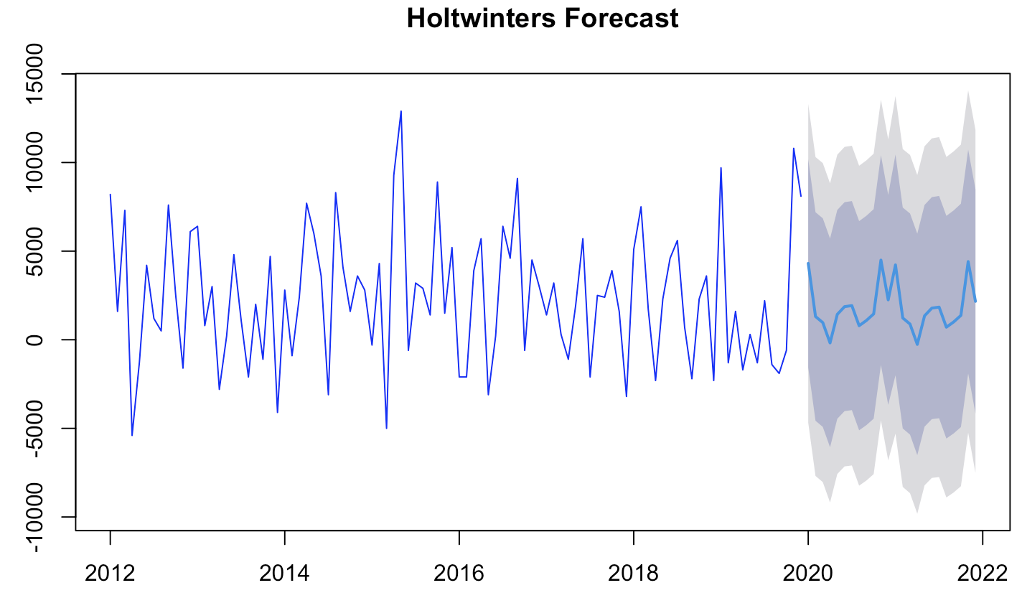
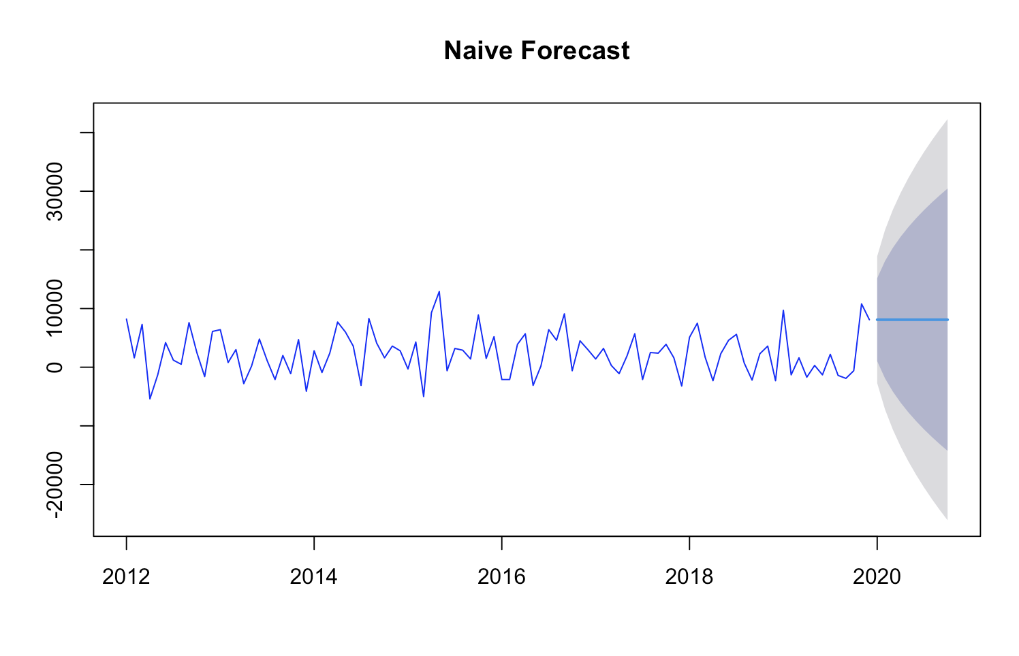
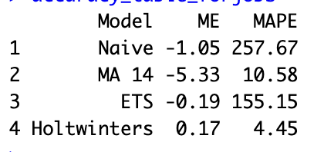
Results form Naïve, MA 14, SES, and HoltWinters

Slide 7
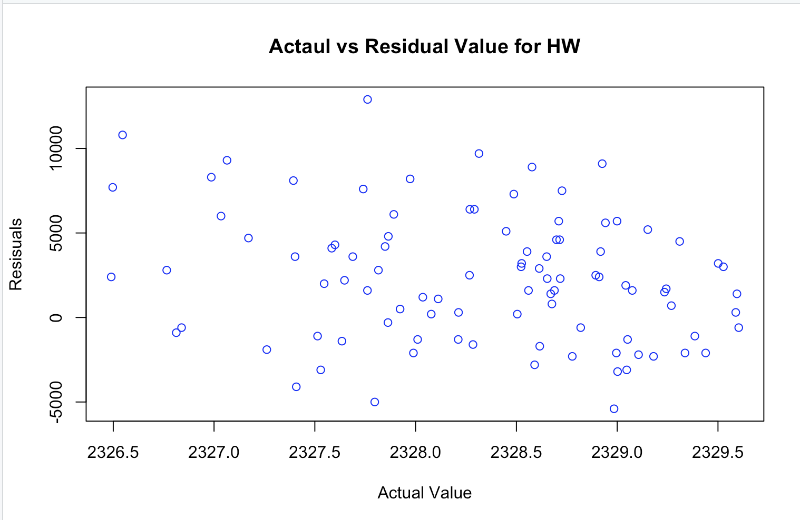
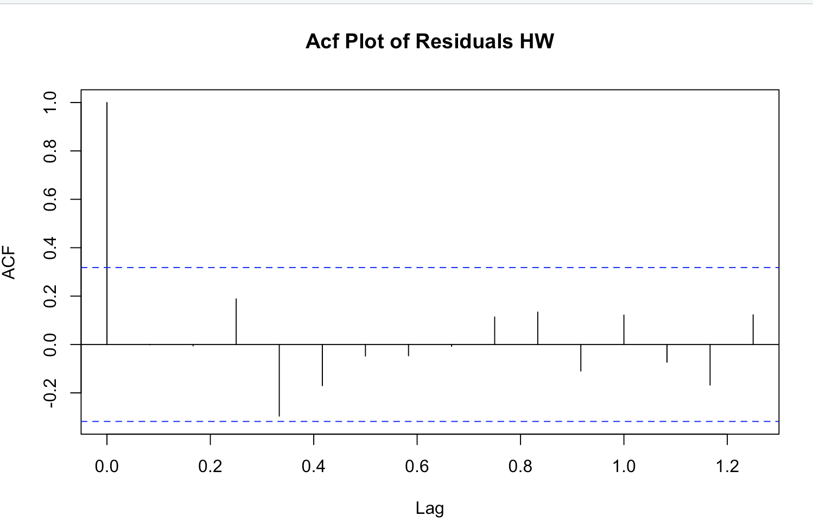
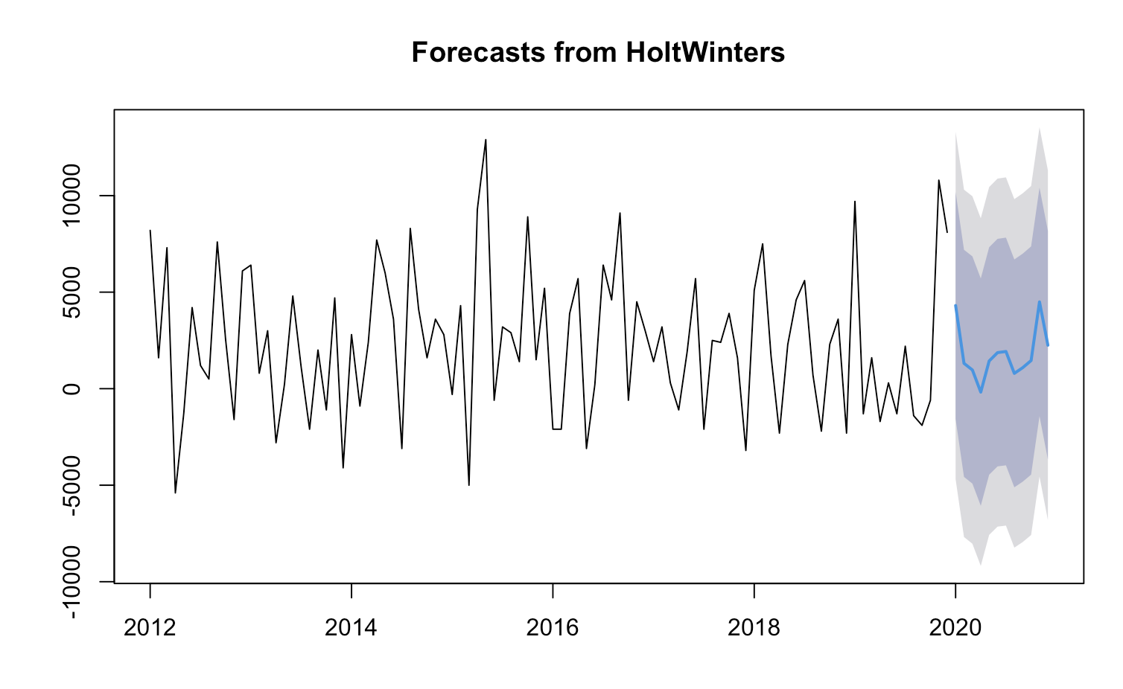
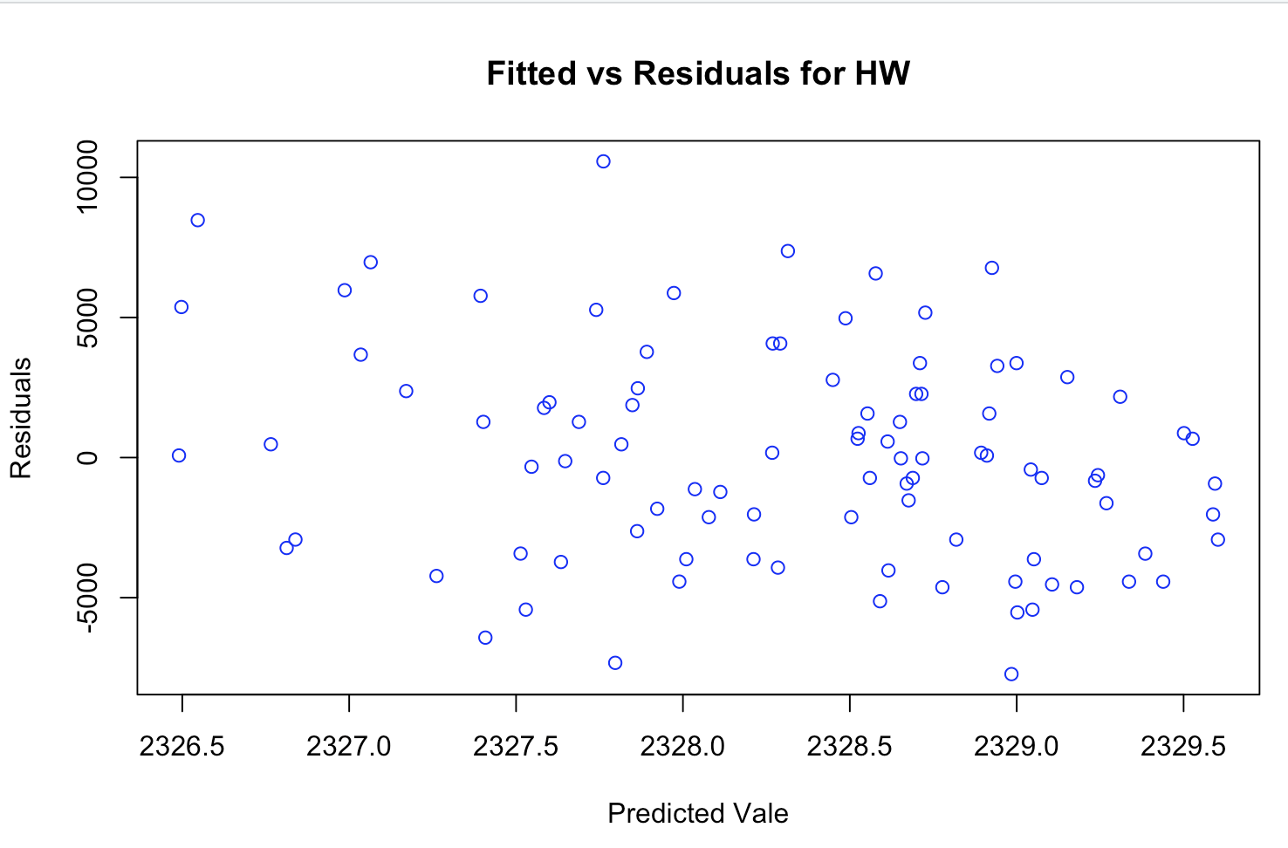
Recommendation:
HoltWinters has the best Mape, Residual Analysis shows white noise

Slide 8
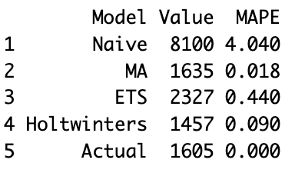
Forecast Conclusion:
HoltWinters has the best Mape and best ME. In actuality, performed the second best in predicting October 2020

Slide 9

Ideas to improve
Run multiple models to find the best MA
Plot Mape overtime

Slide 10
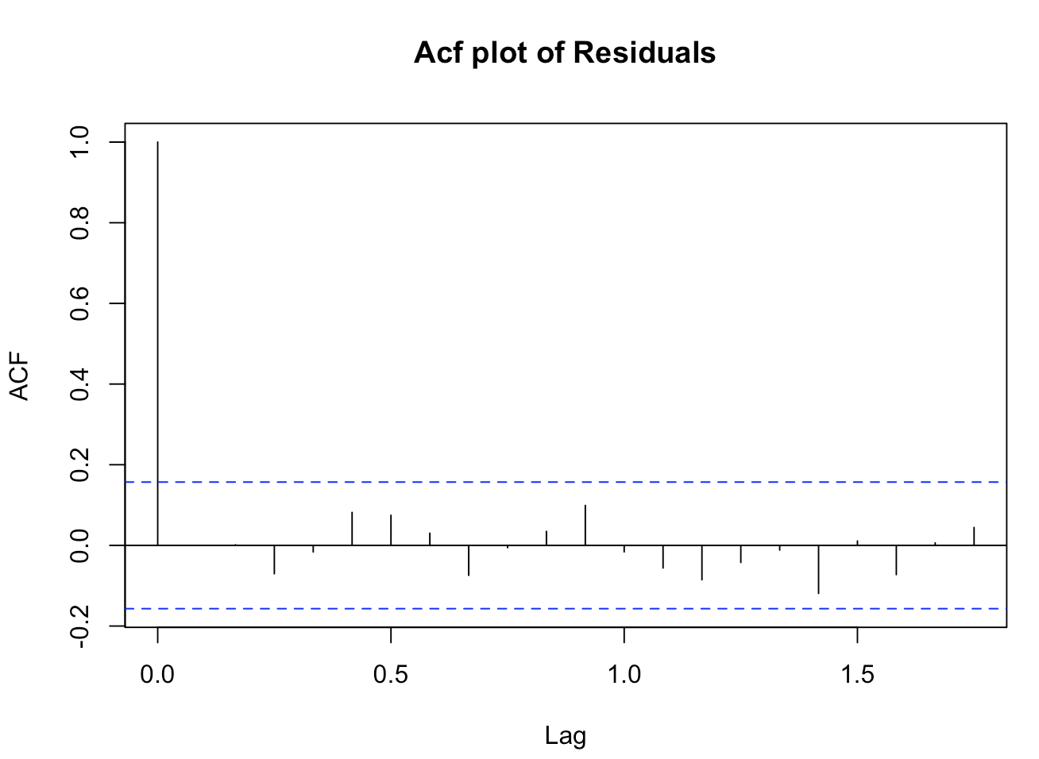
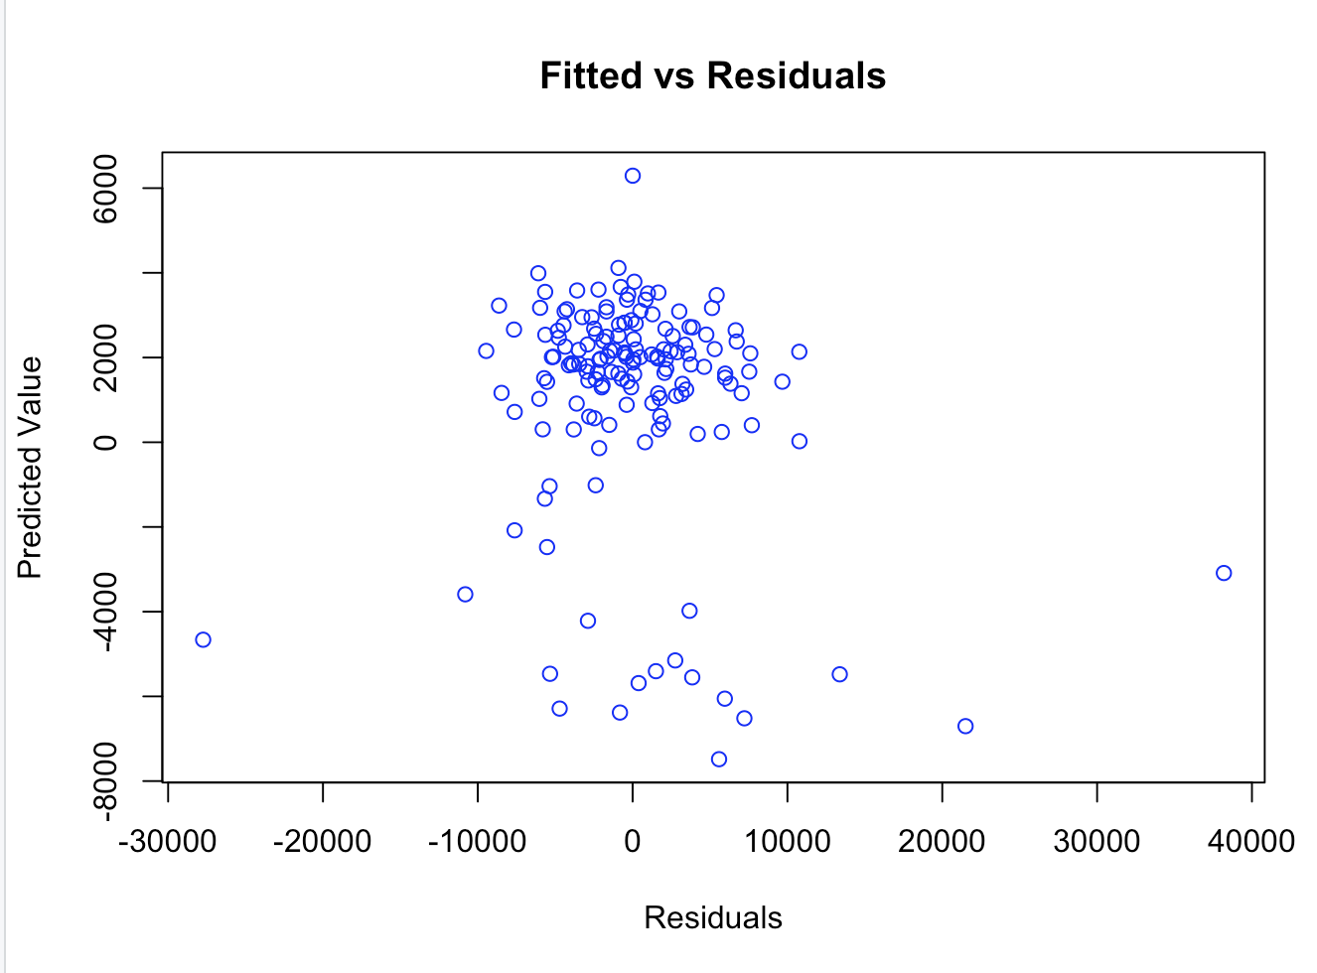
Arima
Mape if INF, difficult to compare
ME: 24.81, not the best model, residuals do not look random

Slide 11
Thank You!

